Slide 1
Activities from June 2025 to June 2026
Zenabu Suboi
Cohort implementation in OM (with Christian)
Teaching at Summer school in Kenya
Simulation set-up, running and analysis of results
Update of ITN parameterization
Rerunning simulation and analysis of results
Assistance: Cohort implementation in OM
Final course work
Presentation of results to CHAI
Presentation at Second Annual PhD Committee Meeting
Manuscript writing

Slide 2

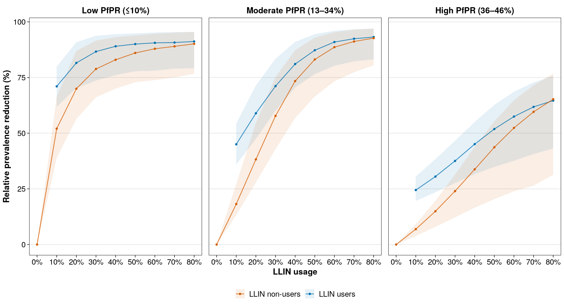
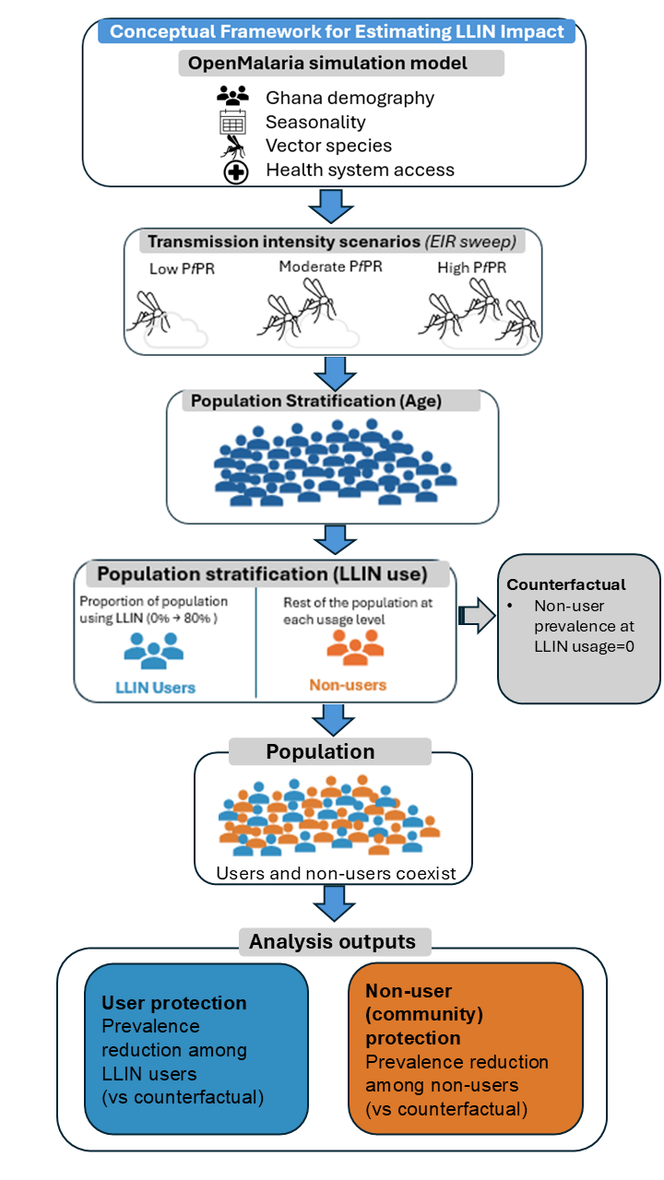
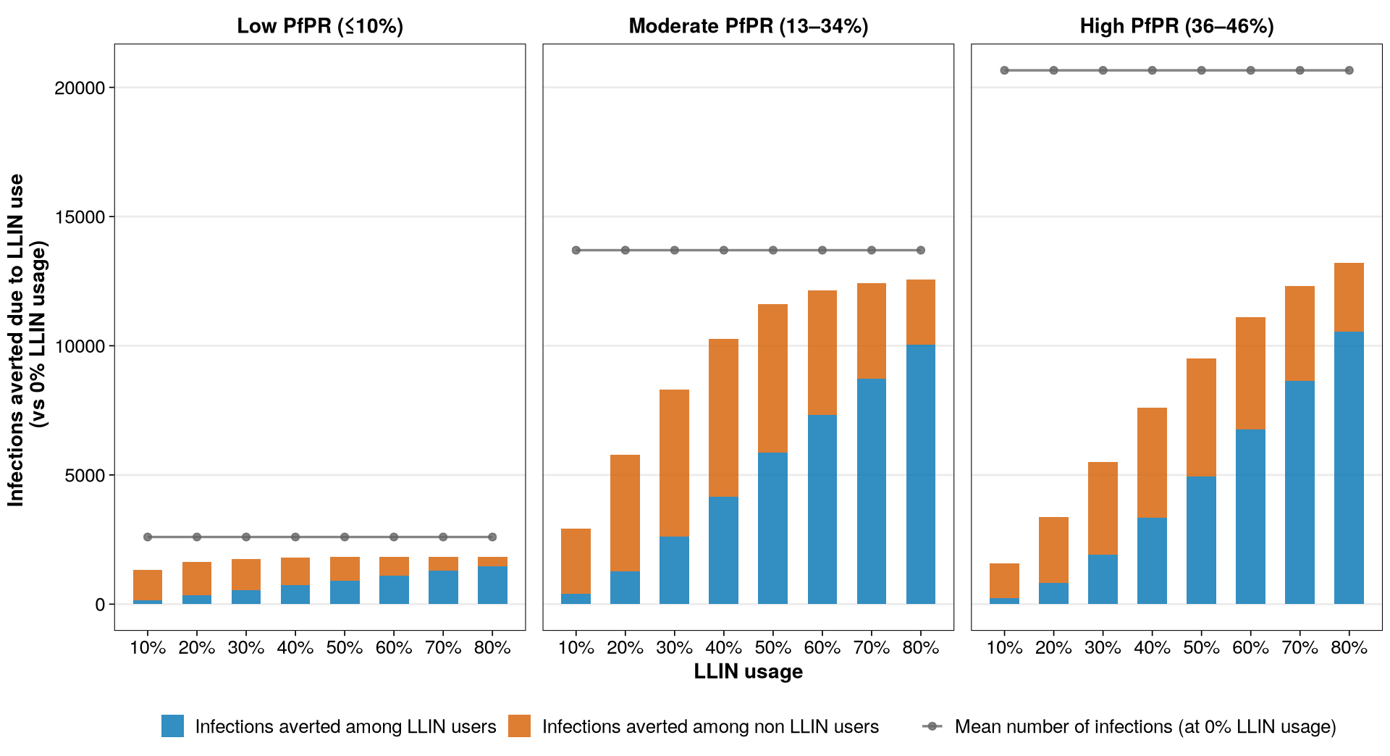
Evaluating the Community Effects of LLINs across Transmission Intensities
Zenabu Suboi
1. Question
How does the protection offered by LLINs vary among LLIN users and non-users across transmission intensities and effective usage levels?
How did I go about it?
2. Answer
Community protection is stronger and plateau in low and moderate settings, but not in high
3. Challenges
Cohort implementation in OpenMalaria
Transitioning to the new ITN parameterization
Finding the right figures to better communicate the message
4. Conclusion
Results suggest moderate LLIN usage in low and moderate PfPR settings, and high usage for high PfPR
Notes:
To correctly print, use the "create and share Adobe PDF" function on the "home" tab of PowerPoint - it will not correctly print if you use the normal print function.

Slide 3
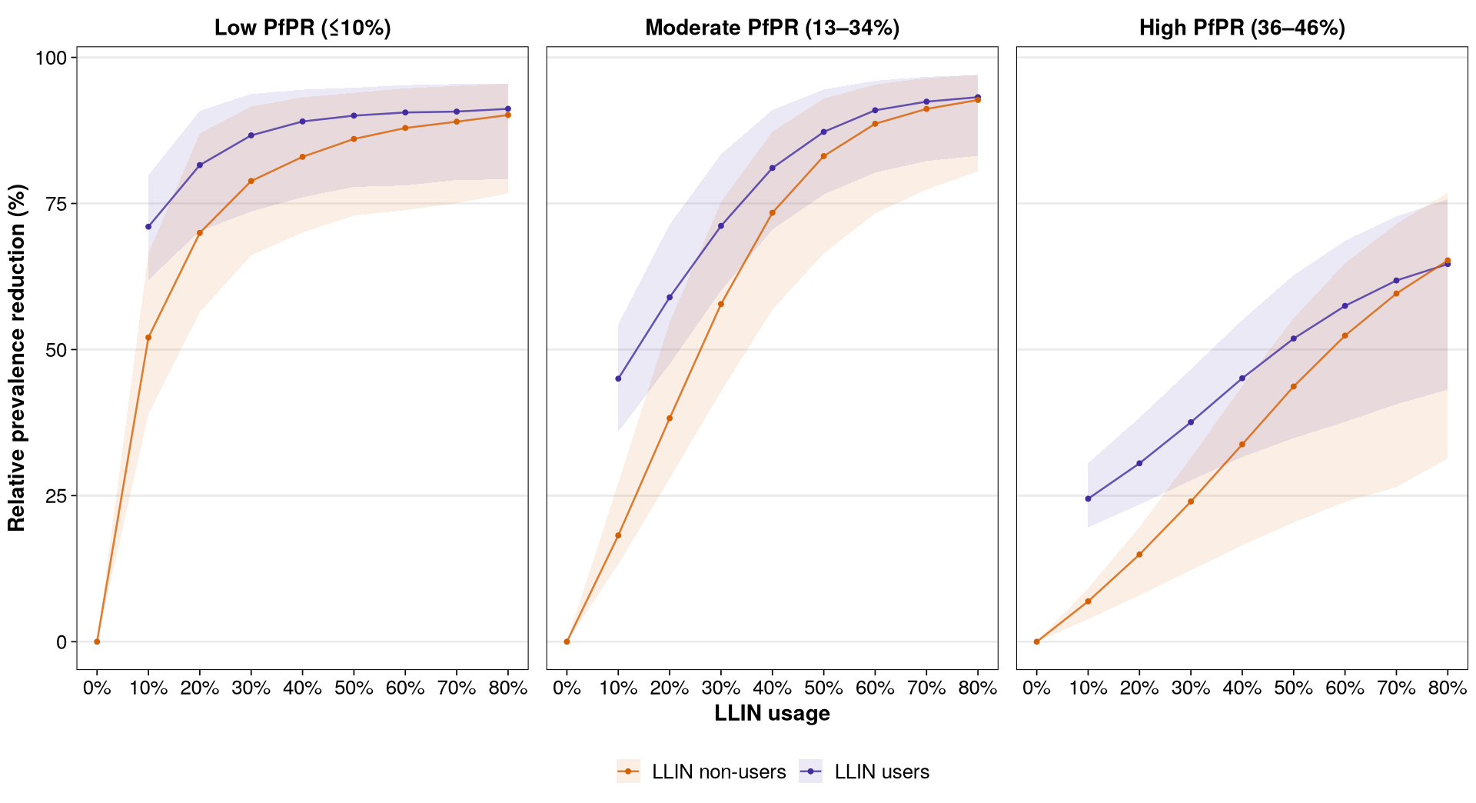
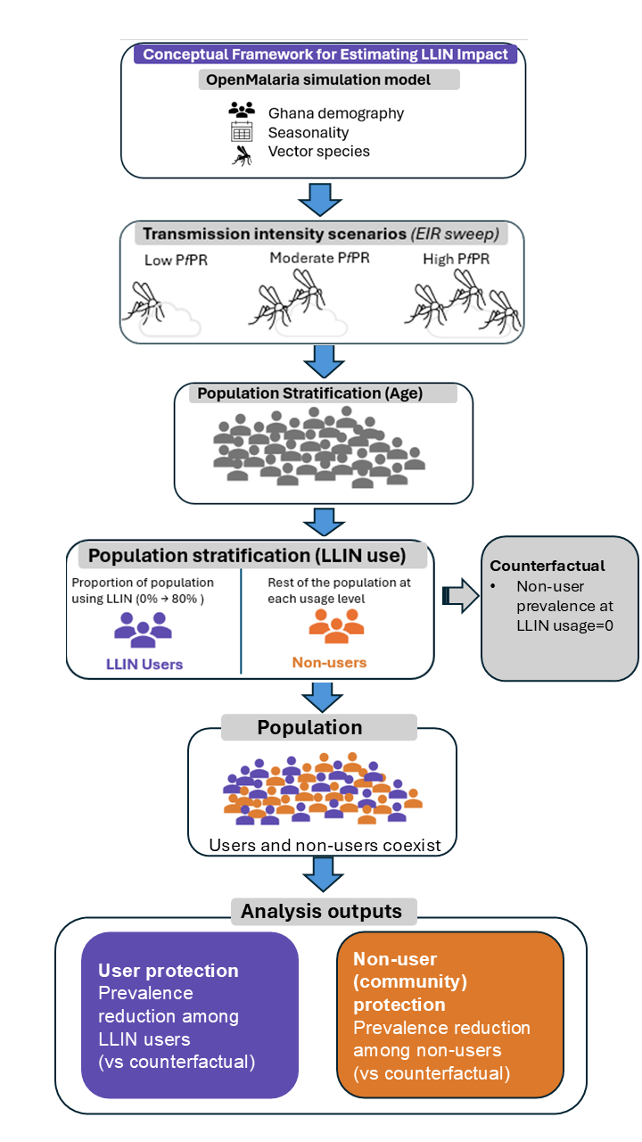
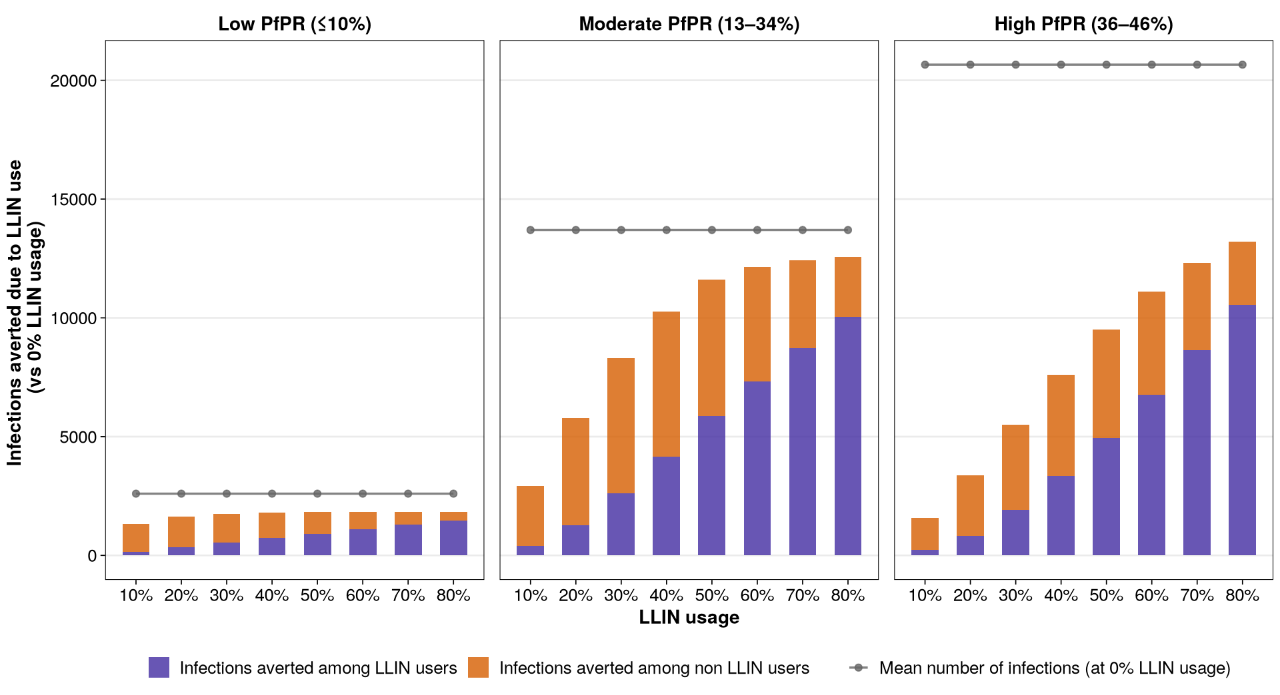
Evaluating the Community Effects of LLINs across Transmission Intensities
Zenabu Suboi
1. Question
How does the protection offered by LLINs vary among LLIN users and non-users across transmission intensities and effective usage levels?
How did I go about it?
2. Answer
Community protection is stronger and plateau in low and moderate settings, but not in high
3. Challenges
Cohort implementation in OpenMalaria
Transitioning to the new ITN parameterization
Finding the right figures to better communicate the message
4. Conclusion
Results suggest moderate LLIN usage in low and moderate PfPR settings, and high usage for high PfPR
Notes:
To correctly print, use the "create and share Adobe PDF" function on the "home" tab of PowerPoint - it will not correctly print if you use the normal print function.

